Slide 1
Behaviour of firms in perfectly competitive markets
K. Narayanan
HS 101 Economics

Slide 2
WHAT IS A COMPETITIVE MARKET?
A competitive market has many buyers and sellers trading identical products so that each buyer and seller is a price taker.
  Buyers and sellers must accept the price determined by the market.

Slide 3
The Meaning of Competition
A perfectly competitive market has the following characteristics:
  There are many buyers and sellers in the market.
  The goods offered by the various sellers are largely the same. Product homogeneity.
  Firms can freely enter or exit the market.
  All the buyers and sellers are price takers.

Slide 4
The Meaning of Competition
As a result of its characteristics, the perfectly competitive market has the following outcomes:
  The actions of any single buyer or seller in the market have a negligible impact on the market price.
  Each buyer and seller takes the market price as given.

Slide 5
The Revenue of a Competitive Firm
Total revenue for a firm is the selling price times the quantity sold.
TR = (P × Q)
Total revenue is proportional to the amount of output.

Slide 6
The Revenue of a Competitive Firm
Average revenue tells us how much revenue a firm receives for the typical unit sold.
Average revenue is total revenue divided by the quantity sold.

Slide 7
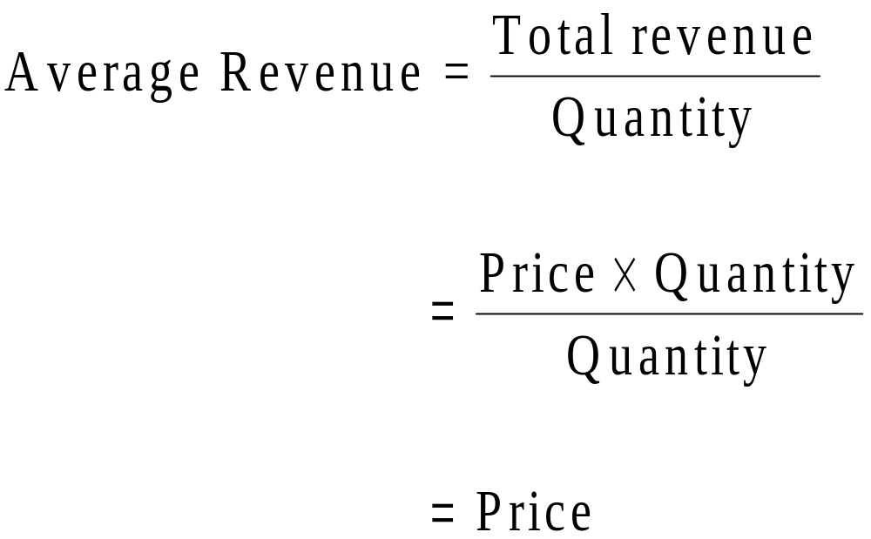
The Revenue of a Competitive Firm
In perfect competition, average revenue equals the price of the good.

Slide 8
The Revenue of a Competitive Firm
Marginal revenue is the change in total revenue from an additional unit sold.
MR =ΔTR/ΔQ
For competitive firms, marginal revenue equals the price of the good.

Slide 9
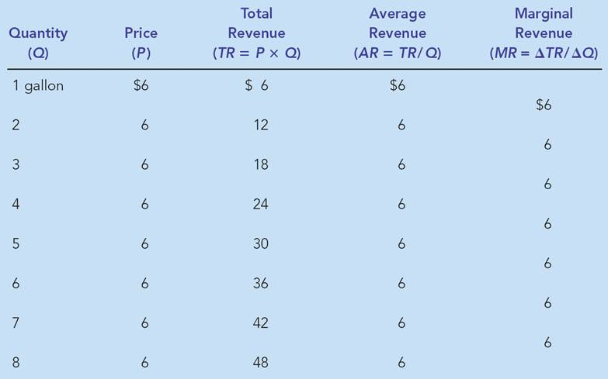
Table 1 Total, Average, and Marginal Revenue for a Competitive Firm

Slide 10
PROFIT MAXIMIZATION AND THE COMPETITIVE FIRM’S SUPPLY CURVE
The goal of a competitive firm is to maximize profit.
This means that the firm will want to produce the quantity that maximizes the difference between total revenue and total cost.

Slide 11
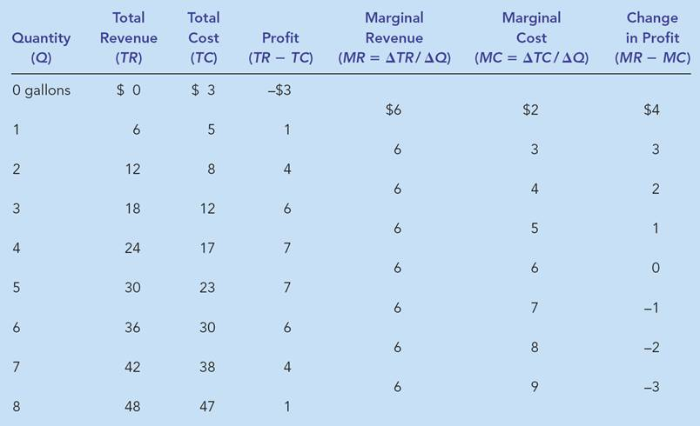
Table 2 Profit Maximization: A Numerical Example

Slide 12
The Marginal Cost-Curve and the Firm’s Supply Decision
Profit maximization occurs at the quantity where marginal revenue equals marginal cost.
  When MR > MC, increase Q
  When MR < MC, decrease Q
  When MR = MC, profit is maximized.

Slide 13
Figure 1 Profit Maximization for a Competitive Firm
Costs
and
The firm maximizes
Suppose the market price is P.
Revenue
profit by producing
the quantity at which
marginal cost equals
MC
marginal revenue.
If the firm produces Q₂, marginal cost is MC₂.
MC
2
ATC
P
=
MR
1
=
MR
2
P
=
AR
=
MR
AVC
MC
If the firm produces Q₁, marginal cost is MC₁.
1
0
Q
1
Q
MAX
Q
2
Quantity

Slide 14
Figure 2 Marginal Cost as the Competitive Firm’s Supply Curve
As P increases, the firm will select its level of output along the MC curve.
Price
So, this section of the
firm’s MC curve is
also the firm’s supply
curve.
MC
P
2
ATC
P
1
AVC
0
Q
1
Q
2
Quantity

Slide 15
The Firm’s Short-Run Decision to Shut Down
A shutdown refers to a short-run decision not to produce anything during a specific period of time because of current market conditions.
Exit refers to a long-run decision to leave the market.

Slide 16
The Firm’s Short-Run Decision to Shut Down
The firm shuts down if the revenue it gets from producing is less than the variable cost of production.
  Shut down if TR < VC
  Shut down if TR/Q < VC/Q
  Shut down if P < AVC

Slide 17
Figure 3 The Competitive Firm’s Short-Run Supply Curve
Costs
Firm
’
s short-run
If P > ATC, the firm will continue to produce at a profit.
supply curve
MC
ATC
If P > AVC, firm will continue to produce in the short run.
AVC
Firm
shuts
down if
P
<
AVC
0
Quantity

Slide 18
Spilt Milk and Other Sunk Costs
The firm considers its sunk costs when deciding to exit, but ignores them when deciding whether to shut down.
  Sunk costs are costs that have already been committed and cannot be recovered.
    It is not the same as the Fixed Costs.

Slide 19
The Firm’s Short-Run Decision to Shut Down
The portion of the marginal-cost curve that lies above average variable cost is the competitive firm’s short-run supply curve.

Slide 20
The Firm’s Long-Run Decision to Exit or Enter a Market
In the long run, the firm exits if the revenue it would get from producing is less than its total cost.
  Exit if TR < TC
  Exit if TR/Q < TC/Q
  Exit if P < ATC

Slide 21
The Firm’s Long-Run Decision to Exit or Enter a Market
A firm will enter the industry if such an action would be profitable.
  Enter if TR > TC
  Enter if TR/Q > TC/Q
  Enter if P > ATC

Slide 22
Figure 4 The Competitive Firm’s Long-Run Supply Curve
Costs
Firm
’
s long-run
supply curve
MC = long-run S
Firm
enters if
P > ATC
ATC
Firm
exits if
P < ATC
0
Quantity

Slide 23
Measuring Profit in Our Graph for the Competitive Firm
Profit = TR – TC
Profit = (TR/Q – TC/Q) x Q
Profit = (P – ATC) x Q

Slide 24
Figure 5 Profit as the Area between Price and Average Total Cost
(a) A Firm with Profits
Price
MC
ATC
Profit
P
ATC
P
=
AR
=
MR
0
Q
Quantity
(profit-maximizing quantity)

Slide 25
Figure 5 Profit as the Area between Price and Average Total Cost
(b) A Firm with Losses
Price
MC
ATC
ATC
P
P
=
AR
=
MR
Loss
0
Q
Quantity
(loss-minimizing quantity)

Slide 26
THE SUPPLY CURVE IN A COMPETITIVE MARKET
The competitive firm’s long-run supply curve is the portion of its marginal-cost curve that lies above average total cost.

Slide 27
THE SUPPLY CURVE IN A COMPETITIVE MARKET
Short-Run Supply Curve
  The portion of its marginal cost curve that lies above average variable cost.
Long-Run Supply Curve
  The marginal cost curve above the minimum point of its average total cost curve.

Slide 28
THE SUPPLY CURVE IN A COMPETITIVE MARKET
Market supply equals the sum of the quantities supplied by the individual firms in the market.

Slide 29
The Short Run: Market Supply with a Fixed Number of Firms
For any given price, each firm supplies a quantity of output so that its marginal cost equals price.
The market supply curve reflects the individual firms’ marginal cost curves.

Slide 30
Figure 6 Short-Run Market Supply
(a) Individual Firm Supply
(b) Market Supply
Price
Price
MC
Supply
$2.00
$2.00
1.00
1.00
0
100
200
Quantity (firm)
0
100,000
200,000
Quantity (market)
If the industry has 1000 identical firms, then at each market price, industry output will be 1000 times larger than the representative firm’s output.

Slide 31
The Long Run: Market Supply with Entry and Exit
Firms will enter or exit the market until profit is driven to zero.
In the long run, price equals the minimum of average total cost.
The long-run market supply curve is horizontal at this price.

Slide 32
Figure 7 Long-Run Market Supply
(a) Firm
’
s Zero-Profit Condition
(b) Market Supply
Price
Price
MC
ATC
P
= minimum
Supply
ATC
0
Quantity (firm)
0
Quantity (market)

Slide 33
The Long Run: Market Supply with Entry and Exit
At the end of the process of entry and exit, firms that remain must be making zero economic profit.
The process of entry and exit ends only when price and average total cost are driven to equality.
Long-run equilibrium must have firms operating at their efficient scale.

Slide 34
Why Do Competitive Firms Stay in Business If They Make Zero Profit?
Profit equals total revenue minus total cost.
Total cost includes all the opportunity costs of the firm.
In the zero-profit equilibrium, the firm’s revenue compensates the owners for the time and money they expend to keep the business going.

Slide 35
A Shift in Demand in the Short Run and
Long Run
An increase in demand raises price and quantity in the short run.
Firms earn profits because price now exceeds average total cost.

Slide 36
Figure 8 An Increase in Demand in the Short Run and Long Run
(a) Initial Condition
Market
Firm
Price
Price
MC
ATC
Short-run supply,
S
1
A
Long-run
P
1
supply
P
1
Demand,
D
1
0
Q
1
Quantity (market)
0
Quantity (firm)
A market begins in long run equilibrium.
And firms earn zero profit.

Slide 37
Figure 8 An Increase in Demand in the Short Run and Long Run
The higher P encourages firms to produce more…
An increase in market demand…
…and generates short-run profit.
…raises price and output.
(b) Short-Run Response
Market
Firm
Price
Price
S
1
MC
ATC
P
B
P
2
A
2
P₁
Long-run
P
supply
1
D
2
D
1
0
Q
1
Q
2
Quantity (market)
0
Quantity (firm)

Slide 38
Figure 8 An Increase in Demand in the Short Run and Long Run
Profits induce entry and market supply increases.
(c) Long-Run Response
Firm
Market
Price
Price
S₁
ATC
B
MC
P₂
A
S
2
C
Long-run
P
1
supply
P
1
D
2
D1
0
Q₁
Q₂
Q
3
Quantity (firm)
0
Quantity (market)
The increase in supply lowers market price.
In the long run market price is restored, but market supply is greater.

Slide 39
Why the Long-Run Supply Curve Might Slope Upward
Some resources used in production may be available only in limited quantities.
Firms may have different costs.
Marginal Firm
  The marginal firm is the firm that would exit the market if the price were any lower.

Slide 40
Special cases of Competitive Markets
Constant and Increasing costs
Completely inelastic supply [which produces economic rents], and
Backward bending supply.

Slide 41
Evaluating the market mechanism
Efficiency:
  Pareto efficiency [also known an just efficiency] occurs when no possible reorganisation of production or distribution can make anyone better off without making someone else worse off.
    Under conditions of allocative efficiency, one person’s satisfaction or utility can be increased only by lowering someone else’s utility.
    Maximising economic surplus, i.e., consumers’ & producers’ surplus.

Slide 42
Equilibrium with many consumers and markets
The perfectly competitive market is a device for synthesizing
  The willingness of consumers possessing rupee votes to pay for goods with
  The marginal costs of those goods as represented by firms’ supply.
    Under certain conditions, competition guarantees efficiency, in which no consumer’s utility can be raised without lowering another consumer’s utility. This is true in a world of many factors and products.

Slide 43
Marginal cost as a benchmark of efficiency
Marginal cost is a fundamental concept for efficiency.
For any goal-oriented organization, efficiency requires that the marginal cost of attaining the goal should be equal in every activity.
In a market, an industry will produce its output at minimum total cost only when each firm’s MC is equal to a common price.

Slide 44
Exception to the Rule
Markets may be inefficient in situations where pollution or other externalities are present or when there is imperfect competition or information.
The distribution of incomes under competitive markets, even when it is efficient, may not be socially undesirable or acceptable.

Slide 45
Several questions arise
Positive economics cannot say how much govts should intervene to correct the inequalities and inefficiencies of the market place
The normative questions are appropriately answered through political debate and fair elections.
  The subject matter of economics can offer valuable insights into the merit of alternative iterventions so that the goals of a modern society can be achieved in the most effective manner.

Slide 46
Because a competitive firm is a price taker, its revenue is proportional to the amount of output it produces.
The price of the good equals both the firm’s average revenue and its marginal revenue.

Slide 47
To maximize profit, a firm chooses the quantity of output such that marginal revenue equals marginal cost.
This is also the quantity at which price equals marginal cost.
Therefore, the firm’s marginal cost curve is its supply curve.

Slide 48
In the short run, when a firm cannot recover its fixed costs, the firm will choose to shut down temporarily if the price of the good is less than average variable cost.
In the long run, when the firm can recover both fixed and variable costs, it will choose to exit if the price is less than average total cost.

Slide 49
In a market with free entry and exit, profits are driven to zero in the long run and all firms produce at the efficient scale.
Changes in demand have different effects over different time horizons.
In the long run, the number of firms adjusts to drive the market back to the zero-profit equilibrium.

